Slide 1


AI & ML for Process Analytical Technology using Python Day 3: Modeling for PAT with Python
João Coutinho
CInTech: Polo Tecnológico de Inovação, Translação e Industrialização de Medicamentos Injetáveis Complexos
Projeto nº 30 – Referência 7131, (Código do projeto: C644865576-00000005)

Slide 2
Data collection and acquisition
Excel spreadsheets, .csv files
SQL databases/historians
Extract data from databases
Extract data from databases or spreadsheets
Data storage
On-line sensors or off-line laboratory analysis
Experiments
Transform or clean data for analysis
Exploratory data analysis
Statistical analysis (univariate and multivariate)
Data visualization
Define goals and hypothesis
What to want to predict?
What to use for prediction?
Build models
Decision making
Define modeling hypothesis
Is the model good for our goals?
Day 3
Day 3
Day 3

Slide 3
Day 3 overview
Part 1: Introduction to PAT
Part 2: Linear regression and introduction to scikit-learn
Linear regression and model fit assessment
Introduction to scikit-learn
Linear regression assumptions
Part 3: Spectroscopic data modeling
Penalized linear regression and latent variable methods
Feature importance and interpretation
Spectral data pre-processing
Part 4: Model tuning, assessment and validation with scikit-learn
Training and testing datasets
Pre-processing and modeling pipelines in scikit-learn
Cross-validation and hyper-parameter optimization

Slide 4
Part 1: Introduction to PAT

Slide 5
Soft sensors and Process Analytical Technology
Soft sensors:
models used to predict variables based on auxiliary data from cheaper/faster sensors/instruments
On- or at-line Quality Prediction (for operation, monitoring and control)
Oil and Gas
Food industry
Chemicals
Pharmaceutical
process analytical technology (PAT)
SOFT SENSORS
LABORATORY
?
Easy
Fast
Inexpensive
Robust
Complex
Time Consuming
Expensive
Uncertainty
MODEL
RON
FFA
Aromatics
…
Notes:
RON - Research Octane Number (RON)

Slide 6
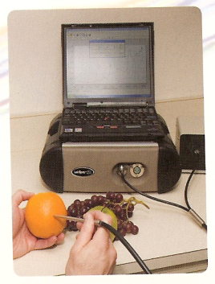
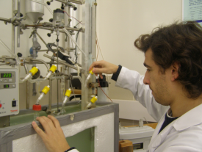
Application: Multivariate Spectra Calibration
Tipically, we look at individual bands/frequencies of spectroscopic data
We want to use all spectra bands to predict a given property – Multivariate Regression/Calibration
Laboratory Analysis
Wet-chemistry
NIR spectra (780-2500 nm)
Sugar content(w%)
20.8
14.2
9.4
7.5
5.3
4.1
…
…
λ*
Wavelength (nm)

Slide 7
Part 2: Linear regression

Slide 8
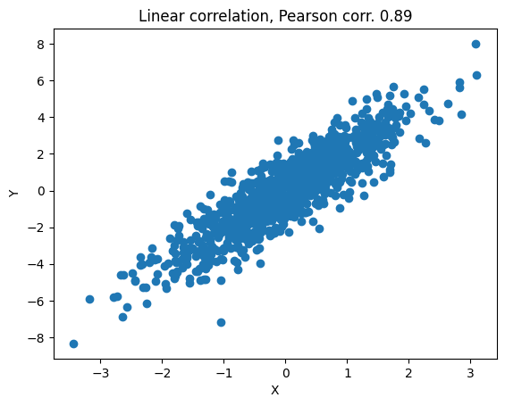
Overview of data-driven modeling
Until now, we have looked at univariate and multivariate correlation: how do temperature and pressure correlate?
Tipically, we mainly insterested in prediction: for a new temperature value of X, what is the pressure?
What is the correlation between Y and X?
How can we use X to predict Y?
New X
New Y?
Prediction

Slide 9
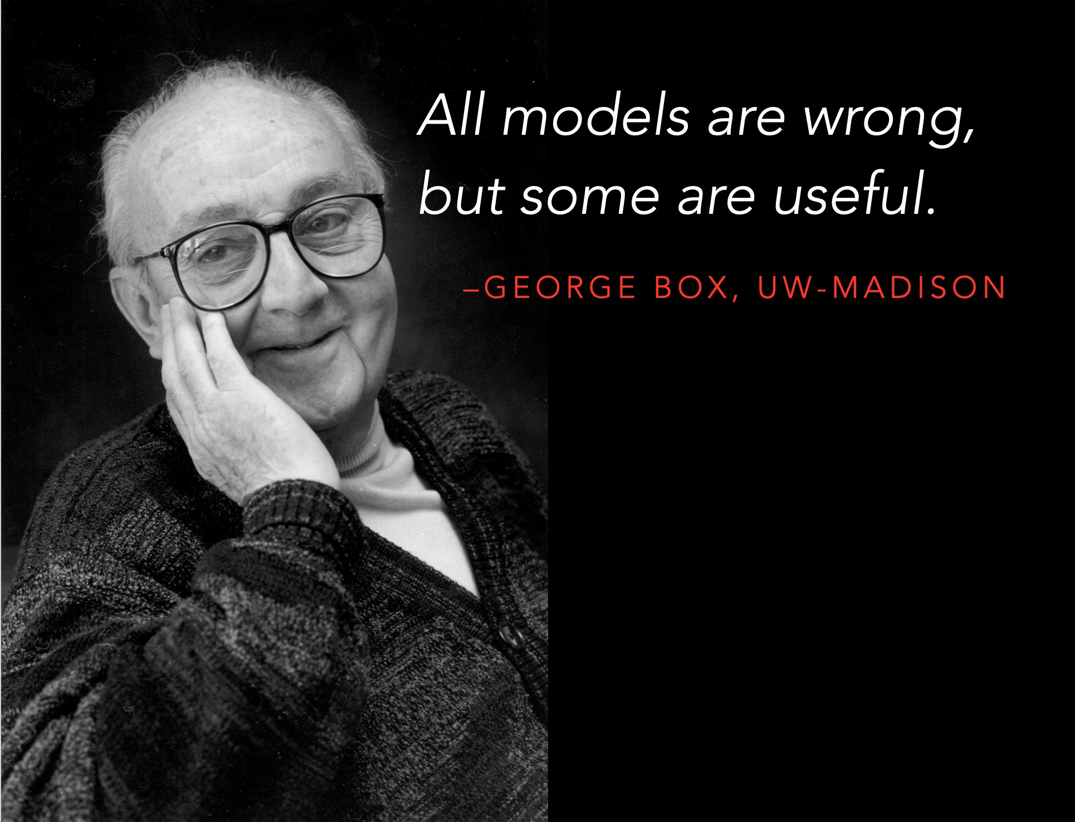
Overview of data-driven modeling
In this workshop, we will use a statistical data-driven modeling approach
Noise, external disturbances
Prior beliefs
and knowledge
Modeling
Inputs
Real world system
Outputs
Inputs
Mathematical model
Outputs
Models are always “wrong” – we can’t perfectly predict the real world
However, this does not stop us to build models to achieve a specific goal

Slide 10
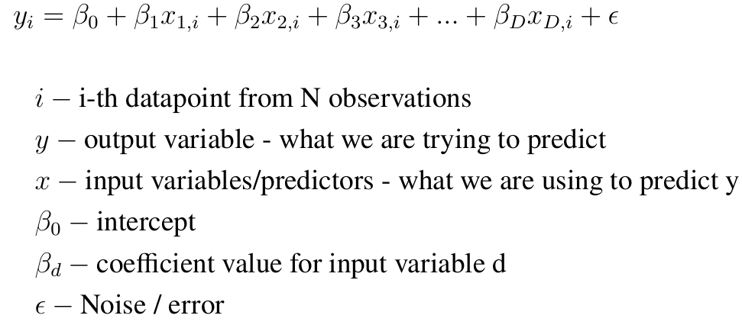
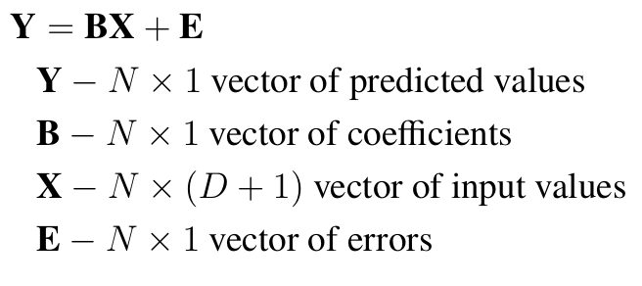
Linear regression - introduction
Linear regression is the simplest form of data-driven modeling and machine learning
In matrix form

Slide 11
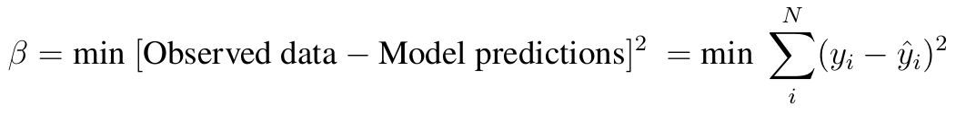
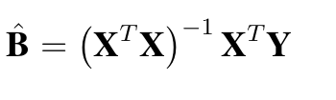
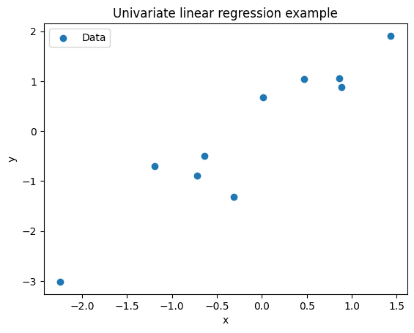
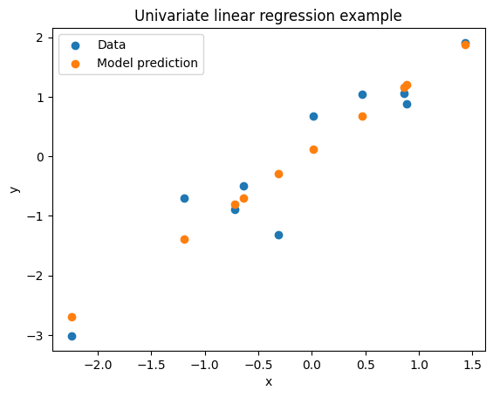
Linear regression - introduction
The model parameters are estimated by minimizing the squared prediction error (least squares)
This problem has analytical solution
We will first focus on univariate (single input) linear regression
Fit model using Least squares

Slide 12
Linear regression - assumptions
Linear regression has several strong assumptions:
Linearity: inputs are related to the output in a linear way
Normality: the distribution of the output variable values is considered Normal
Constant noise variance: noise is stochastic and uncorrelated between observations
If one or more of the assumptions do not hold for the data, linear regression can fail
We will discuss common violations of these assumptions and how to proceed in these cases

Slide 13
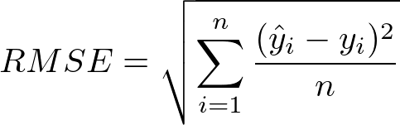
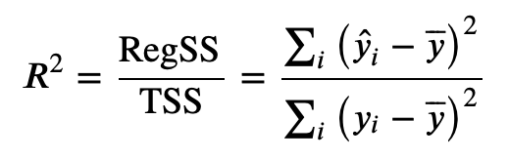
Linear regression – model fit assessment
After fitting a model, we should always check if the fit is good and previous assumptions are met
We can use standard quantiative metrics for model fit
Two reccomended metrics are the Root Mean Squared Error (RMSE) and R squared
Root mean Squared Error (RMSE)
Coefficient of determination (R2 or R squared)
Can be seen as “average” error
Can be used to assess prediction error
Indicates what percentage of variance the model explains
Sensitive to outliers

Slide 14
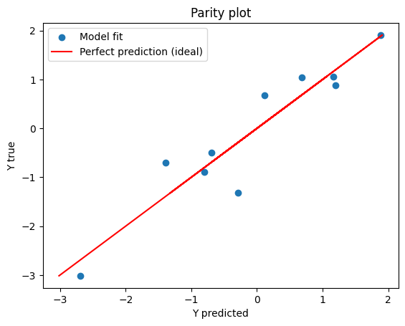
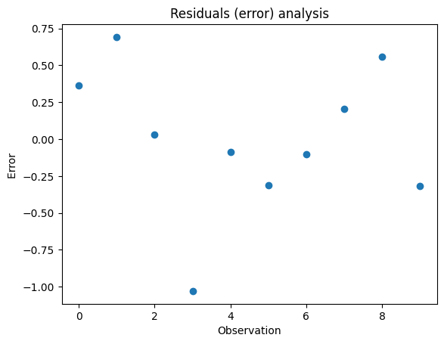
Linear regression – model fit assessment
We can also assess model fit visually
Visual assessment of model fit
(only possible for cases with 1 or 2 inputs)
Predicted vs Real (parity plot)
Residual (error) analysis
There should not be any visual pattern/correlation in the error

Slide 15
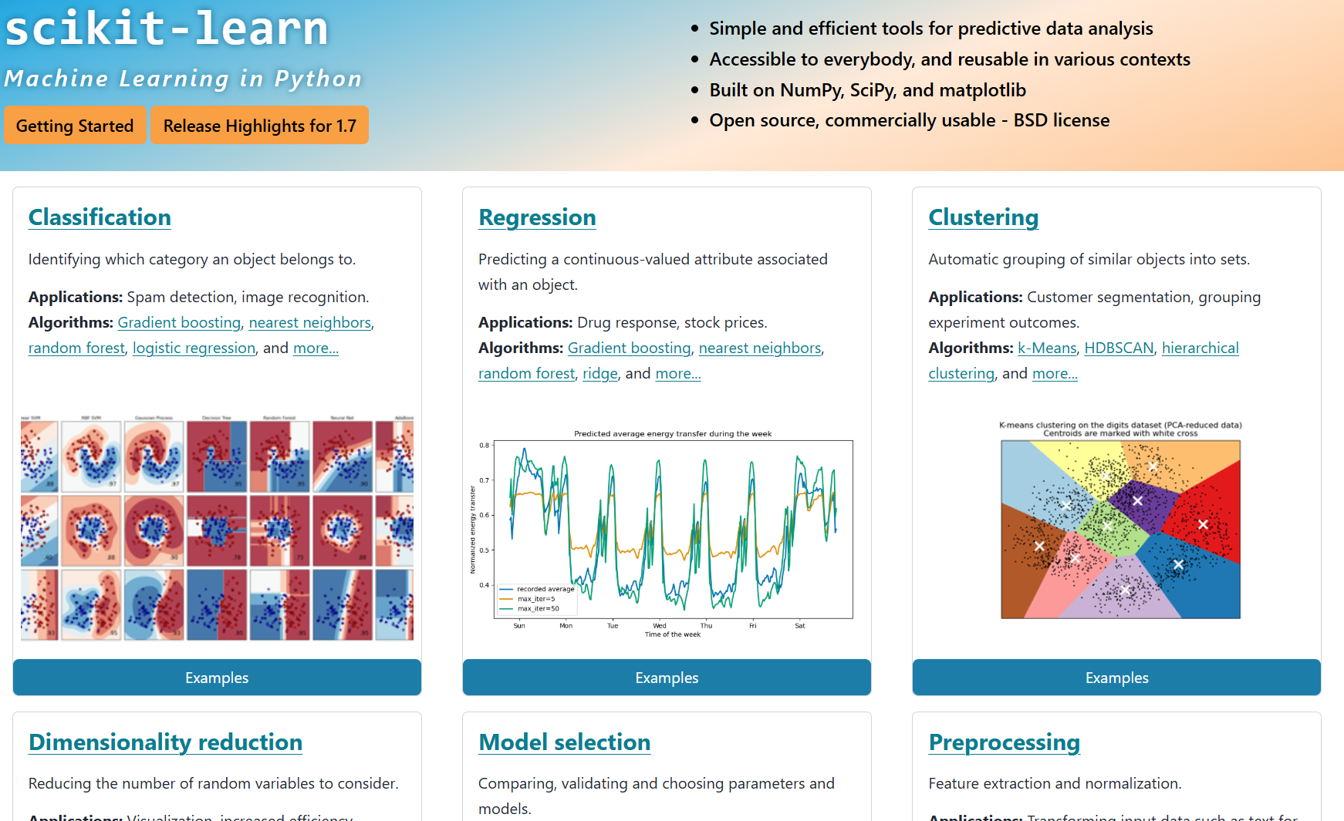
Introduction to scikit-learn
Scikit-learn is a very popular Python package for both basic and advanced machine learning
Documentation is very complete, with many examples and tutorials

Slide 16
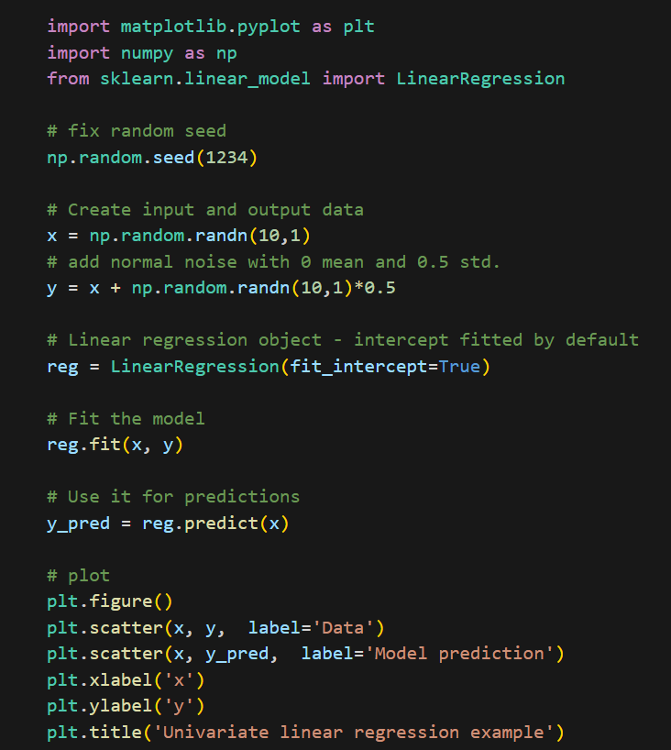
Linear regression using scikit-learn
Scikit-learn models have 3 main methods
1. initiate model
2. Fit to data
3. Predict
y given x

Slide 17
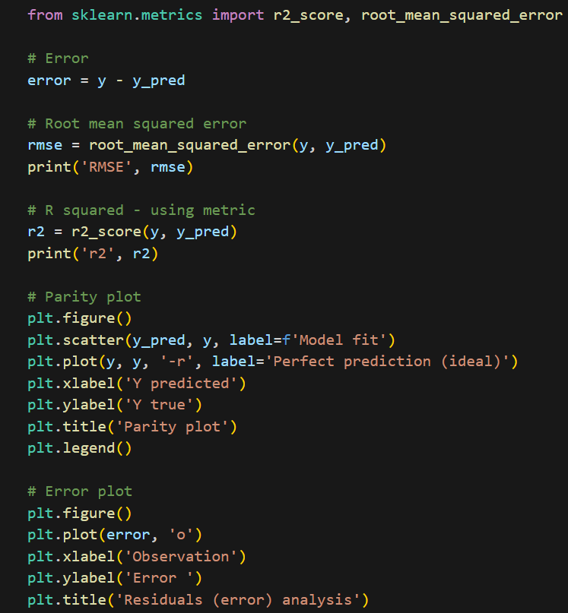
Linear regression using scikit-learn

Slide 18
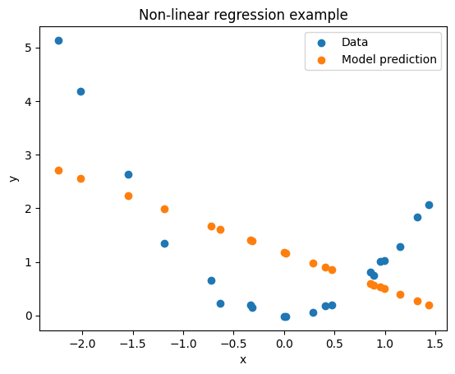
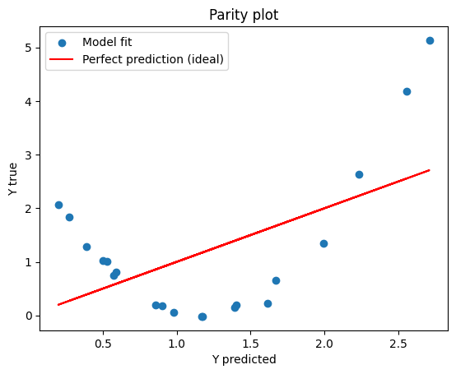
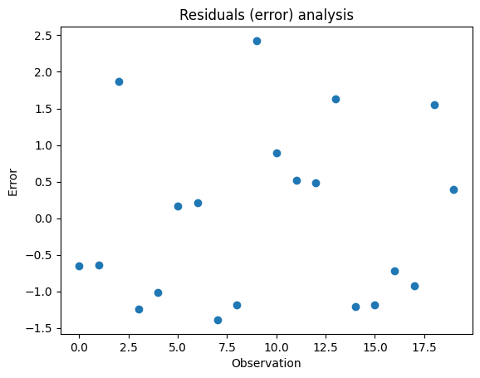
Linear regression – non-linearity assumption
What if the relationship between inputs and output is not linear?
Consider a simple non-linear example, where y = x^2 + noise
Clear non-linear relationship visible between input and output
(only possible for 1 or 2 D cases)
Clear trend in predicted vs real plot
What to do?

Slide 19
Linear regression – non-linearity assumption and feature engineering
We could move beyond linear regression models or perform feature engineering/transformation
Feature engineering: the process of creating new variables from existing data
Let’s revisit the linear regression model structure
Adding features (quadratic and interactions) between variables increases the model flexibility
This linear regression modeln structure is called a polynomial model

Slide 20
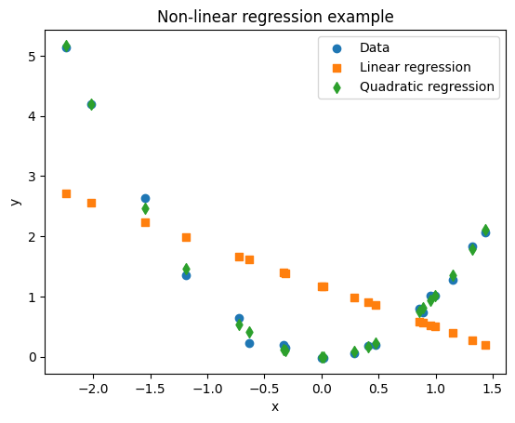
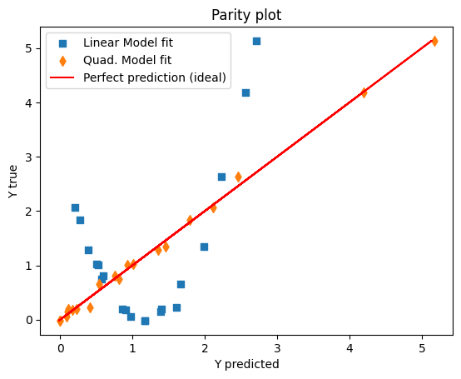
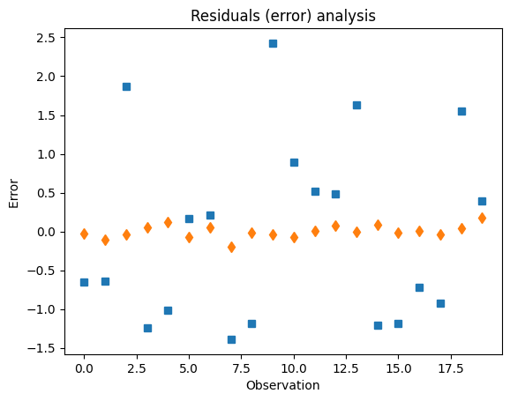
Linear regression – non-linearity assumption and feature engineering
In the previous example, we can add a quadratic feature of the input variable x
Fit is greatly improved by using quadratic feature

Slide 21
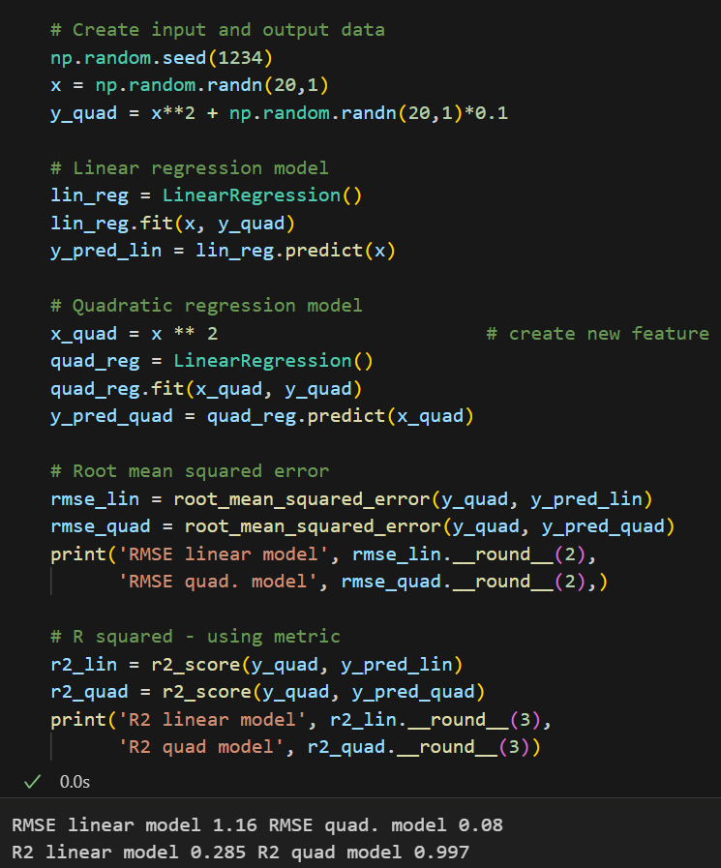
Linear regression – non-linearity assumption
Features can be created by manipulating the numpy arrays
We can use custom transformations using numpy operations

Slide 22
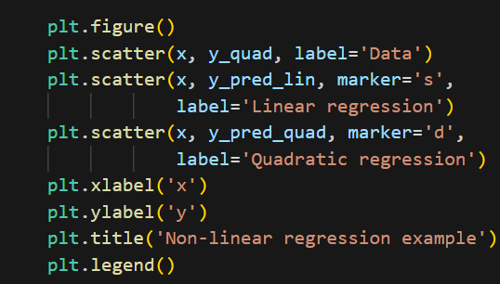
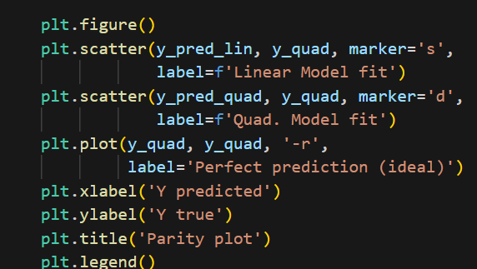
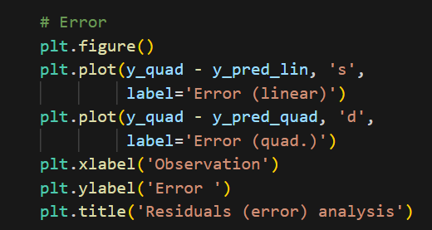
Linear regression – non-linearity assumption

Slide 23
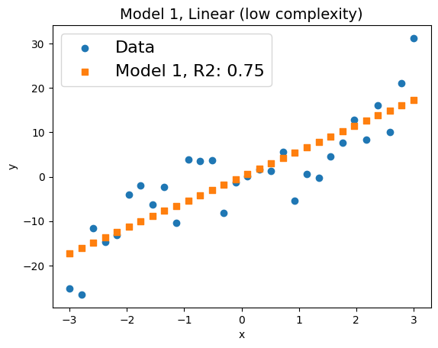
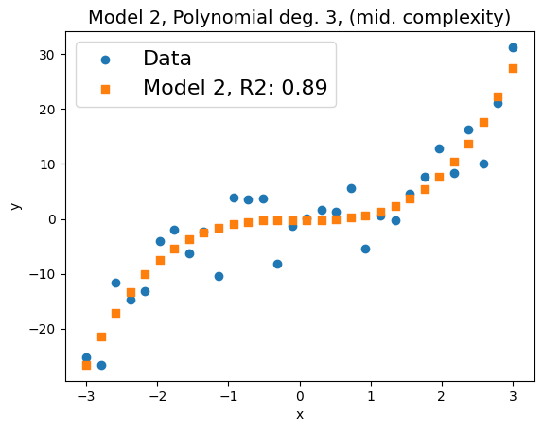
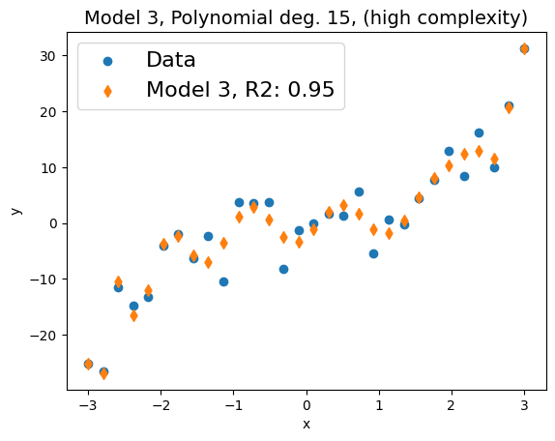
Linear regression – overfitting vs underfitting
Consider noisy non-linear data and fitting of 3 different models
Question:
What is the best model?

Slide 24
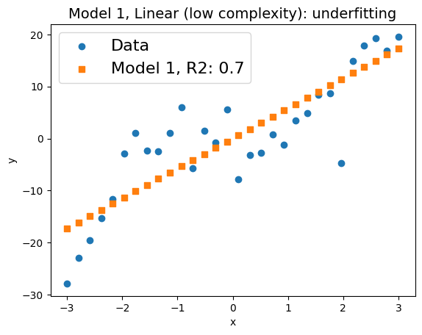
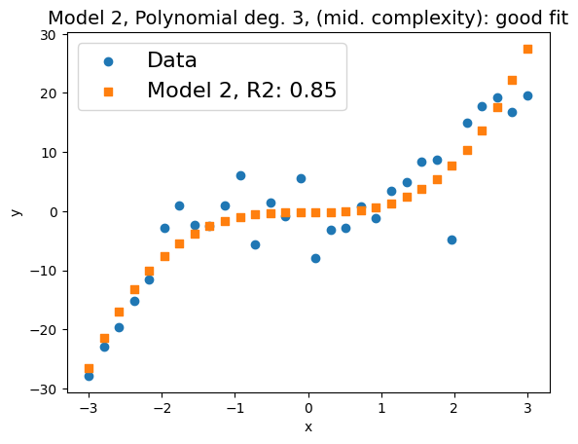
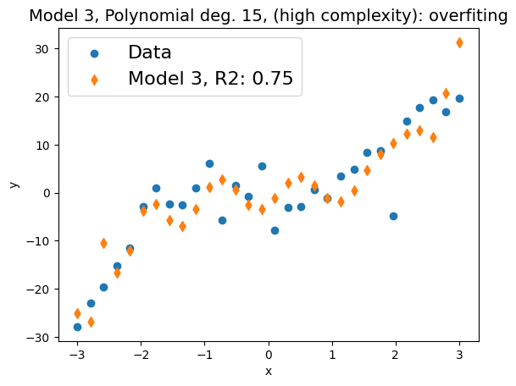
Linear regression – overfitting vs underfitting
Lets look at the model predictions for new data
Change in R squared for the new data:
model 1: 0.75 -> 0.7
model 2: 0.89 -> 0.85
model 3: 0.91 -> 0.75
Model 3 overfitted noise in the data due to many degrees of freedom
Best model is actually model 2: trend (not noise) is well captured and performance (R2) for new data is consistent
We will revisit this issue later during model tuning
“Snaking” Polynomial

Slide 25
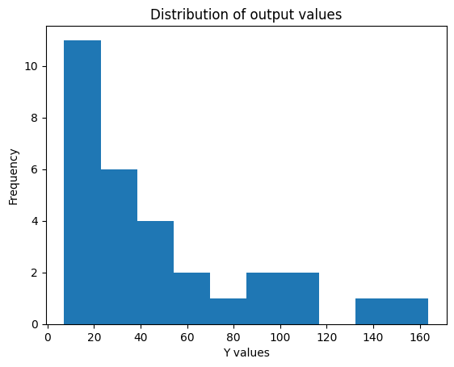
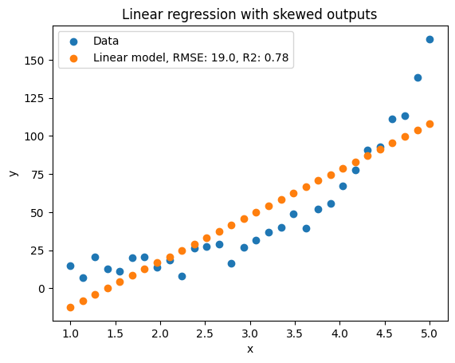
Linear regression – normal distributed outputs assumption
Linear regression assumes that the output values are normally distributed
However, in many cases, we could have a skewed distribution towards low or high values
This can be due to the sampling used to obtain the data
Or indicate a special type of non-linear behavior
Always look at the distribution of the output before building a model – exploratory data analysis
Y = exp (x) + noise
Linear model does not fit the data well

Slide 26
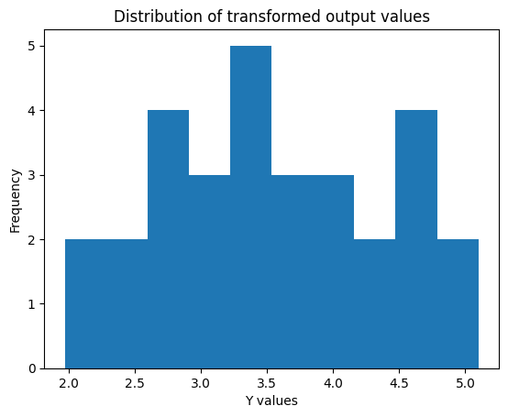
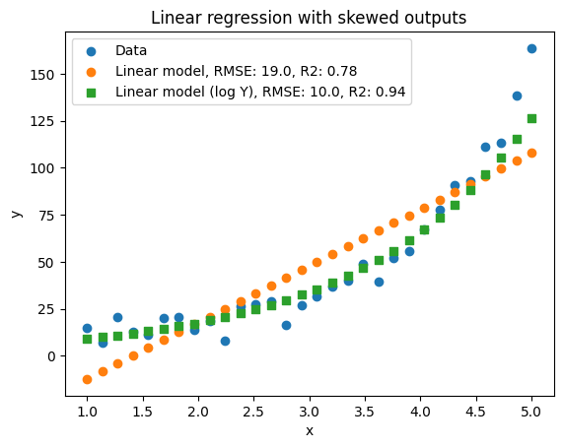
Linear regression – normal distributed outputs assumption
A simple way to deal with skewed distribution is to transform the output variables
For right skewed distributions, a simple transformation is using the logarithm of the output
This is similar to considering a log-normal distribution for the output
Output distribution is right-skewed (big tails to the right)
Output distribution
“looks more normal”
Model fit is improved by simple transformation

Slide 27
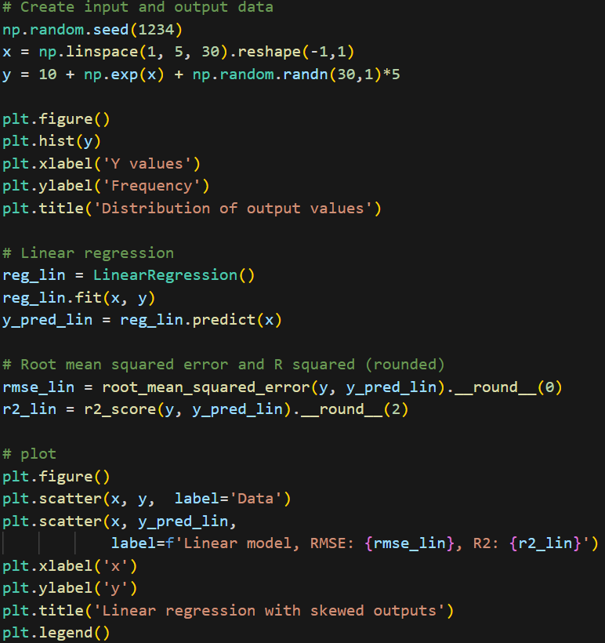
Linear regression – normal distributed outputs assumption

Slide 28
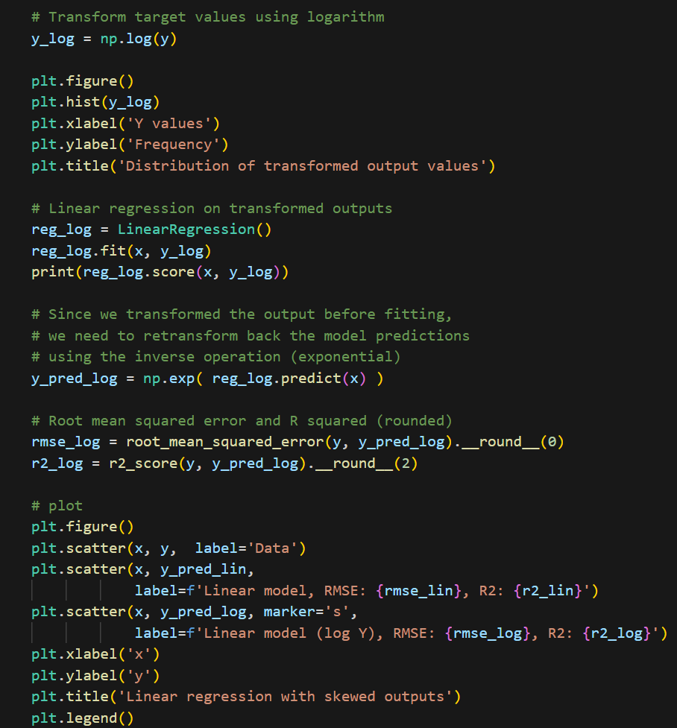
Linear regression – normal distributed outputs assumption

Slide 29

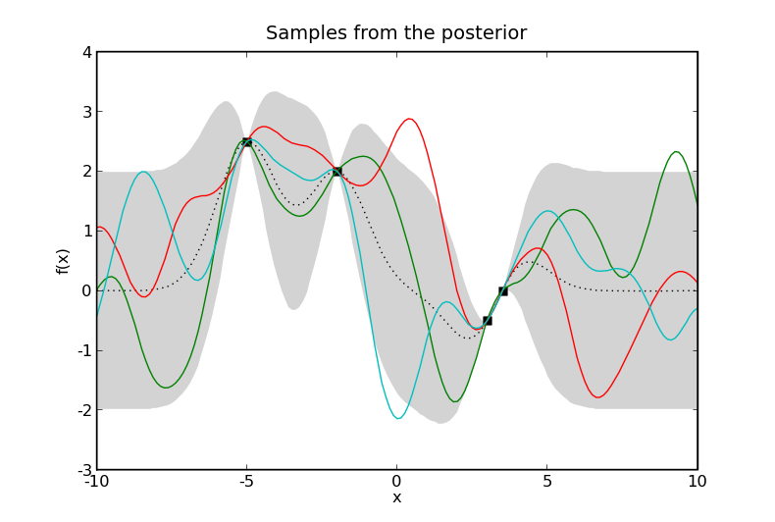
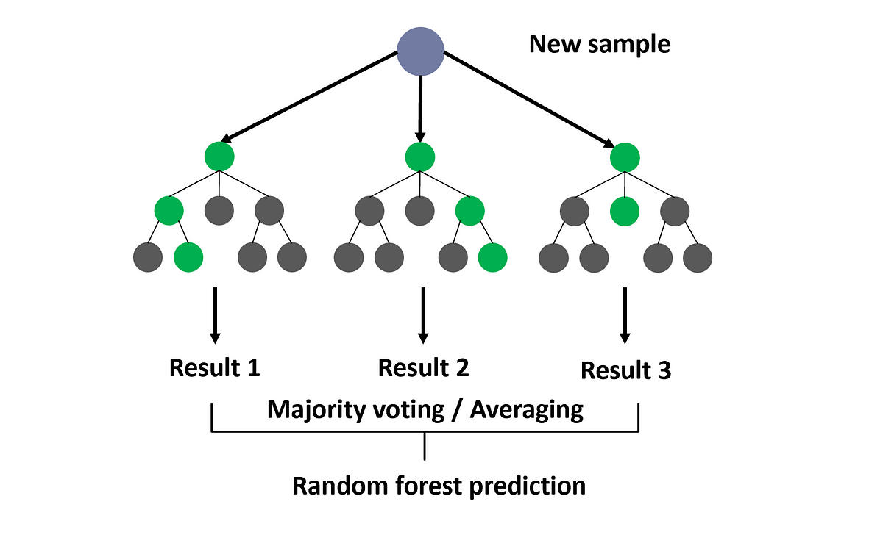
Moving from linear models to other more complex models
Artificial Neural Networks /
Deep Learning (DL)
(ChatGPT and LLMs use DL)
Random forests and tree-based models
Gaussian Processes
(Probabilistic models)

Slide 30
Part 3: Spectroscopic data modeling

Slide 31
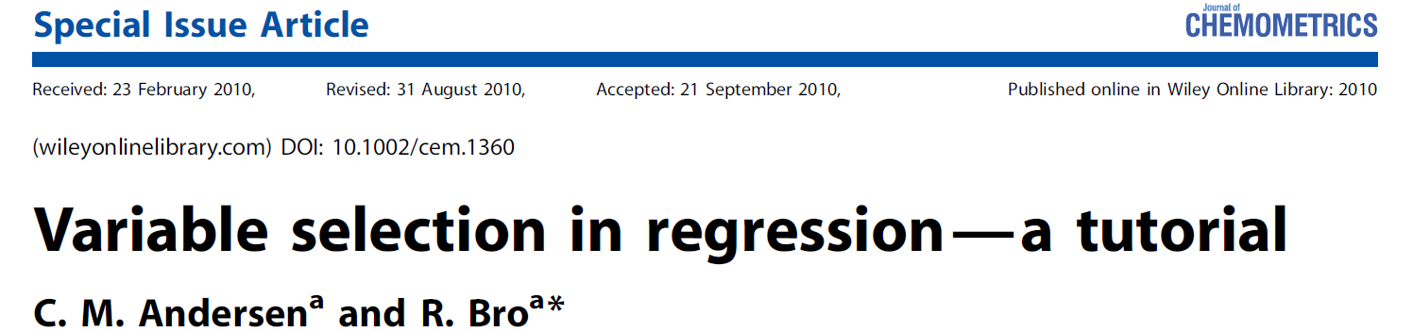
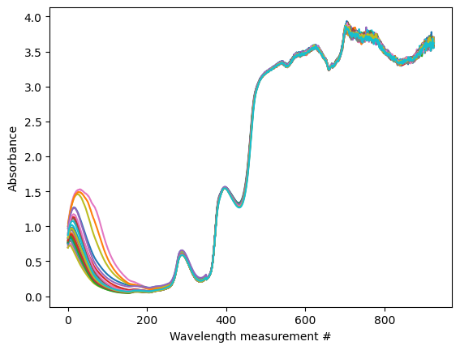
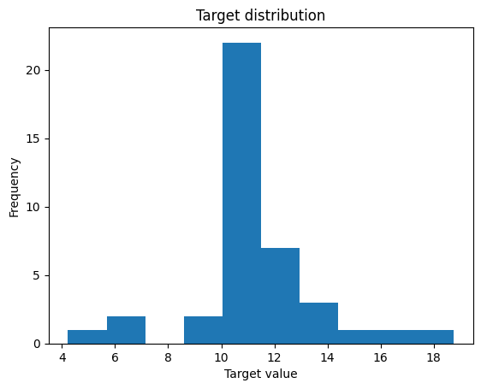
Linear regression for spectroscopic data – motivating example
Beer dataset:
VIS-NIR spectroscopic data of beer samples
926 absorbance measurements at each wavelength
Target variable is a beer quality parameter (extract)
How can we predict the beer quality parameter based on the spectroscopic absorbance data?
Extract = function (absorbance) ?

Slide 32
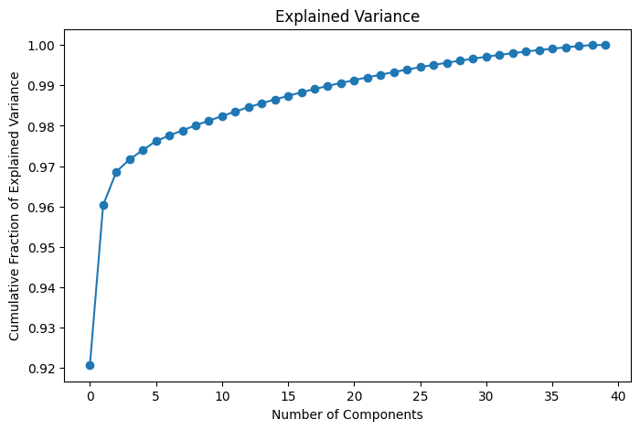
Linear regression – revisiting independence assumption for spectroscopic data
Spectroscopic data is tipically very high dimensional (100s to 1000s of variables)
We saw that when using PCA, the individual measurements have intrinsic lower dimensionality
Spectroscopic input variables are tipically very correlated – this is called collinearity
Are all these variables really independent?
One PC in PCA explains > 90% variability
(variables are very correlated)
X1
X10
X926

Slide 33
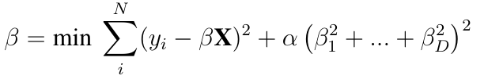
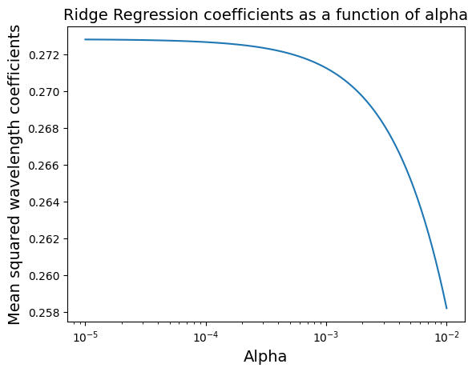
Penalized linear regression – ridge regression
Penalized Regression deals with correlation in the inputs by imposing a penalization term in the least squares fitting
Ridge regression imposes a positive penalty alpha on the sum of squared coefficients values (squared L2 norm)
This penalization avoids overfitting to data by penalizing coefficients with large magnitude (regularization)
Ridge regression in beer dataset:
the larger the value of alpha, the smaller the mean value of the squared coefficients

Slide 34

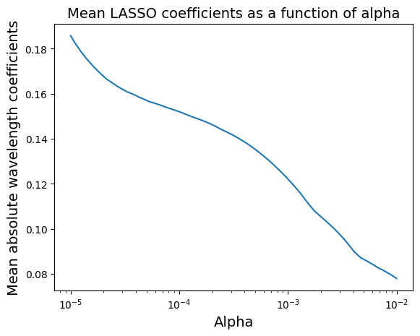
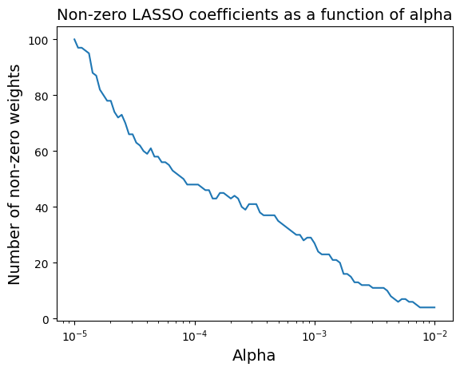
Penalized linear regression – LASSO regression
LASSO regression also considers a positive penalization but on the sum of absolute values (L1 norm)
Different from Ridge regression, LASSO can remove input variables from prediction – variable selection
As alpha increases, more variables have a zero coefficient and thus are eliminated from the model

Slide 35
Penalized linear regression – bias-variance trade-off
The alpha parameter in penalized regression controls the bias–variance trade-off
Increasing alpha reduces variance of the parameter estimates but increases bias
More bias (less complexity) reduces variance, avoiding overfitting but decreases model “flexibility”
There is an optimal trade-off – We will discuss this in PART 4

Slide 36
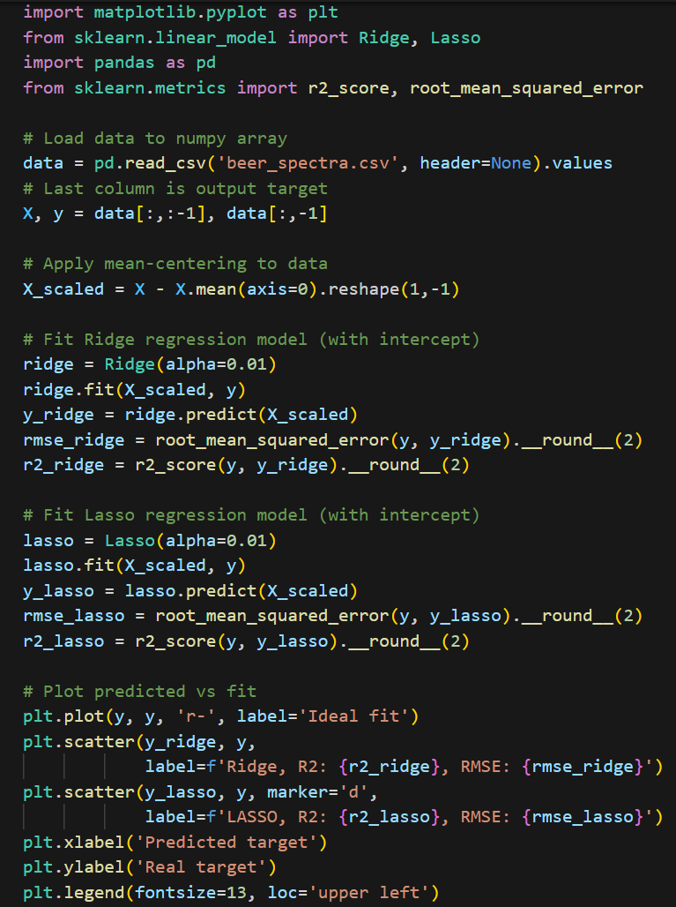

Penalized linear regression in scikit-learn

Slide 37


Latent variable methods – Partial Least Squares
We can also deal with the collinearity issue from a latent variable perspective
Similar to PCA, Partial Least Squares (PLS) is a latent variable method, but for regression purposes
PLS finds a lower subset of uncorrelated (latent) variables that maximize the covariance between X and Y
As with PCA, PLS performs dimensionality reduction and enables regression with 100s to 1000s of variables
After fitting, PLS models can be written as a linear regression equation

Slide 38


Partial Least Squares in scikit-learn

Slide 39
Spectroscopic data modeling – Feature importance analysis
In addition to assessing the quality of the model fit, we also need to interpret the model predictions
For PAT, interpreting the model predictions is critical to make sure we make good control decisions
We can roughly interpret linear model coefficients as the importance of each variable – feature importance
Importance of x1
Importance of x3
Importance of xD

Slide 40



Spectroscopic data modeling – Feature importance analysis
In spectroscopy, large coefficients can give intuition into relevant bands important for predicting the target
What is important about these bands?

Slide 41

Spectroscopic data modeling – Feature importance analysis

Slide 42
Spectroscopic data modeling – Feature importance analysis
Comparing the feature importance results with those of the paper, we find that models align on relevant conclusions
The models are able to capture the correlation between the absorbance around the 1200 nm and the extract parameter
You can look at the model coefficients and compare information available in textbooks about frequency bands

Slide 43

Feature importance in scikit-learn

Slide 44
Overview of modeling methods for spectroscopic data
Model | Robust to collinearity | Variable selection | Sensitive to differences in scale
Linear regression (ordinary least squares) | NO | NO | NO
Ridge Regression | YES | NO | YES
LASSO | YES | YES | YES
Partial Least Squares | YES | NO | YES

Slide 45


Spectroscopic data modeling – pre-processing
Instruments in analytical chemistry are subject to artifacts
These can create non-linearities in the spectra and lead to sub-optimal performance for linear models
Different artifacts influence the data differently
Pre-processing the data/spectra:
“Filters out” the artifacts from the data
Turns relevant bands important (extracts features from spectra)

Slide 46



Spectroscopic data modeling – pre-processing
There are many types and ways for pre-processing spectroscopic data
More than 100 NIR pre-processing methods can be found in the literature (Jiao et al 2020)
We also tipically want to transform the spectra into absorbance scale (for NIR)

Slide 47



Spectroscopic data modeling – pre-processing
We will focus on 4 pre-processing methods:
Mean centering (already covered)
Standard Normal Variate (SNV): each spectra is subtracted its mean and divided by its standard deviation across wavelengths
Saviztky-Golay (SG): fits a 2nd deg. polynomial on a moving window and computes the derivative
We also consider a combination of SNV and SG pre-processing

Slide 48

Spectroscopic data modeling – pre-processing in scikit-learn

Slide 49

Spectroscopic data modeling – pre-processing in scikit-learn

Slide 50

Spectroscopic data modeling – pre-processing in scikit-learn

Slide 51
Spectroscopic data modeling – pre-processing
Spectra pre-processing and predictive model building are very interconnected
No single preprocessing that is optimal for all spectral datasets – best solution is case-dependent
Generally, we have to integrate the pre-procesing step with model selection
How can we choose the best pre-processing?
Trial and error
Visual inspection of pre-processed spectra and prior knowledge
Optimization and exhaustive search over different combinations – Next Part

Slide 52
Part 4: Model tuning, validation and assessment

Slide 53
Training and testing datasets
The goal of building a regression model is to use it to make predictions for new data
If we have enough data, we can assess how the model predicts new data using a test dataset
We should randomly split the data into training and testing subsets
We should always try to leave enough training data to build a good model (70%-90%)
All available
data
Training data
(e.g. 70%)
Testing data
(e.g. 30%)
Calibrate/estimate model parameters
“training”
Asses model predictions for new data
“testing”

Slide 54



Training and testing datasets

Slide 55


Training and testing datasets in scikit-learn
Scikit-learn provides an easy function to split data into training and testing
It can also work on Pandas dataframes

Slide 56
Pre-processing and modeling pipeline
Previously, we saw that different pre-processings and models lead to different predictions
We have to integrate pre-processing with regression model development
Spectroscopic
pre-processing
(MC, SNV, SVG)
Regression model
(RR, LASSO, PLS)
Predict
target value

Slide 57

Pre-processing and modeling pipeline
Defining the pre-processing and modeling steps manually can cause some issues:
Many lines of code
Data leakage from training to testing dataset
Possible error or “forgetting” to transform data
Can we simplify this preprocessing and model pipeline for cleaner and easier code?

Slide 58

Pre-processing and modeling pipeline – scikit-learn’s pipeline
Scikit-learn provides Pipeline - a convenient function for integrating pre-processing and models
All pre-processing and modeling steps are integrated into a single object

Slide 59
Model tuning – hyper-parameters
Model parameters (coefficients) are estimated directly from data
However, the models have parameters that cannot be directly estimated from data – hyper-parameters
Some pre-processing methods (e.g. SG filters) can also have hyper-parameters
Pre-processing | Hyper-parameters
Mean centering | None
Standard Normal Variate (SNV) | None
Saviztky-Golay (SG) | Order of polynomial (fixed to 2) Window size Order of derivative: 1 or 2
SNV-SG | Same as above
Model | Hyper-parameters
Ridge regression | Alpha
LASSO | Alpha
PLS | Number of latent variables / principal components

Slide 60


Model tuning – hyper-parameters
The model hyper-parameters affect how the model generalizes and predicts new data
Increasing the modeling complexity always reduces the training error but may reduce the testing error
Remember: we want to use the model to make predictions for new data
There is an optimal trade-off between fitting the data and generalizing to new data (remember bias-variance trade-off)
RMSE training always decreases
RMSE test starts to increase
Lowest RMSE test

Slide 61
Model tuning – training, validation, testing
If we choose hyper-parameters based only on the test set, we can also overfit
We should consider training/validation/testing datasets
The validation dataset is used to choose hyper-parameters, testing dataset is to used to test
All available
data
Training data
(e.g. 70%)
Testing data
(e.g. 30%)
Training data
(e.g. 80%)
Validation data
(e.g. 20%)
Calibrate and tune the model
Test the performance of the model

Slide 62

Model tuning – cross-validation
Cross-validation (CV) considers multiple splits of data into training and validation
K-fold CV:
Splits the data into K folds
Train the model on K-1 folds
Test the model on fold K
Calculate errors or error metrics
Repeat until all folds have been used
Tipically we set K=5 or 10
If K=N, we are using Leave-One-Out-CV (LOOCV)

Slide 63

Model tuning – cross-validation in scikit-learn

Slide 64


Model tuning – cross-validation and hyper-parameters
We can use CV as a measure for model generalization
We can search for the model (and pre-processing) hyper-parameters that lead to the lowest CV error

Slide 65

Model tuning – hyper-parameters
We want to search for the optimal hyper-parameters that minimize a CV metric
How can we do this easily, with minimal code for multiple models and with multiple sets of hyper-parameters?

Slide 66

Model tuning – hyper-parameter selection
Scikit-learn’s GridSearchCV offers a very convenient method to search over a grid of hyper-parameters
The final model can be easily extracted and used for predictions and deployment

Slide 67

Model tuning – hyper-parameter selection
What about pre-processing hyper-parameters?
There is a caveat to define the SG filter: a custom class has to be created
This class was already created for you in a separate file (custom_sv_filter)

Slide 68
Extra material

Slide 69


Extra materials and learning resources
Other chemometric toolboxes:
Chemometrics toolbox https://chemometrics.readthedocs.io/en/stable/index.html
Further reading materials/technical blog:
https://nirpyresearch.com/ - all things spectra related (data processing, analysis, modeling)

Slide 70
CInTech: Polo Tecnológico de Inovação, Translação e Industrialização de Medicamentos Injetáveis Complexos
Projeto nº 30 – Referência 7131
(Código do projeto: C644865576-00000005)
Projeto Cintech com a referência 7131 financiado pelo PRR - Plano de Recuperação e Resiliência e pelos Fundos Europeus Next Generation EU, na sequência do AVISO N.º 02/C05-i01/2022, Componente 5 – Capitalização e Inovação Empresarial - Agendas Mobilizadoras para a Inovação Empresarial

